Slide 1
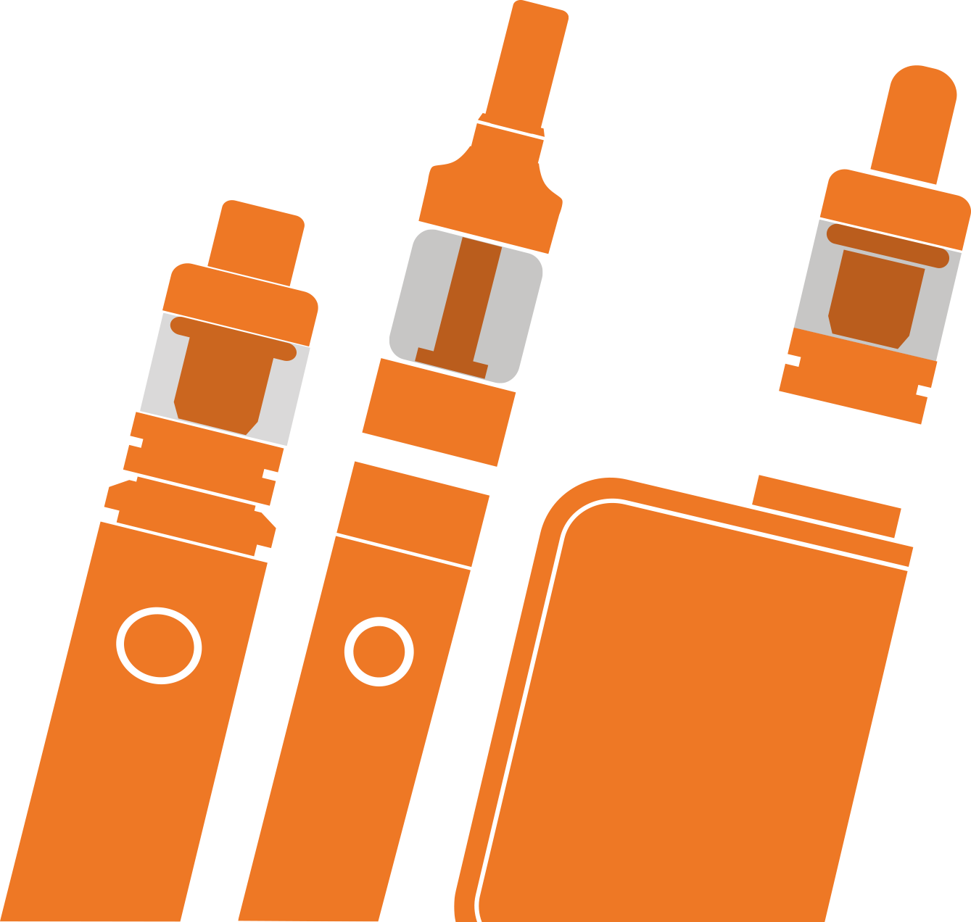

Slide 3
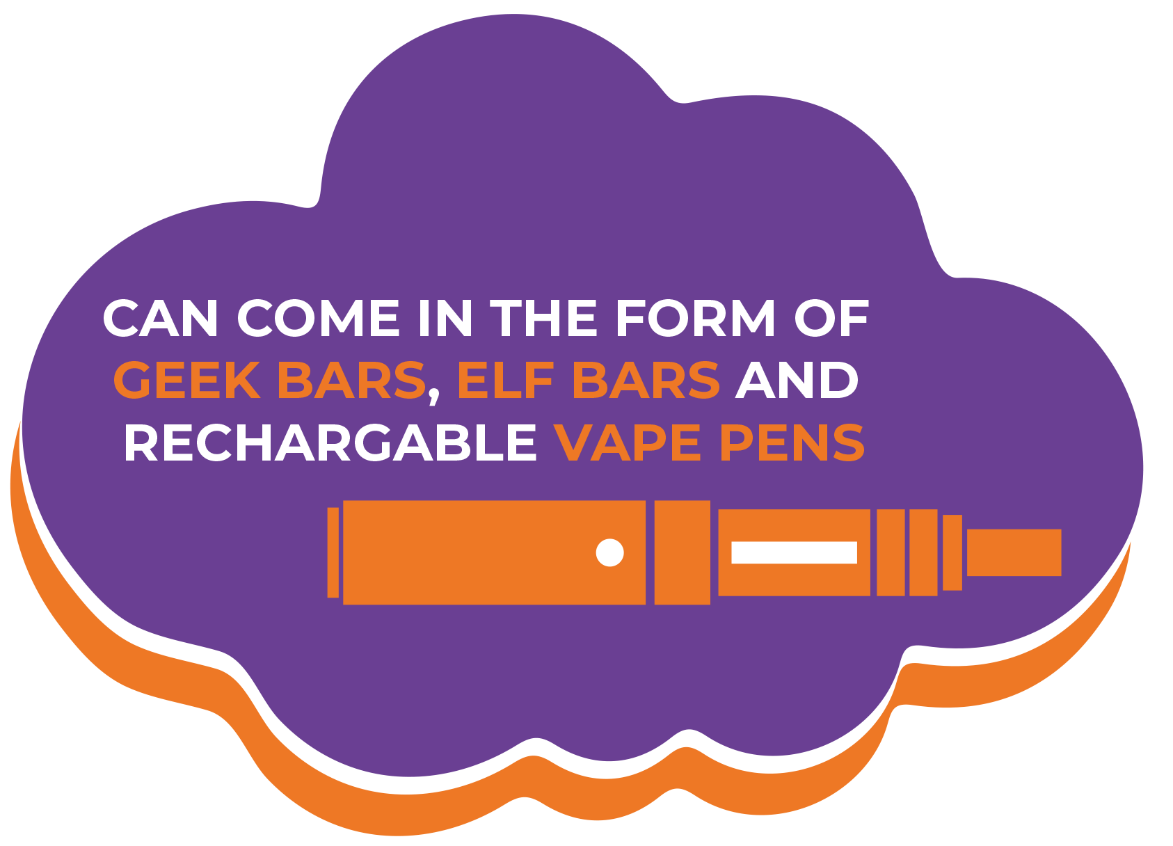
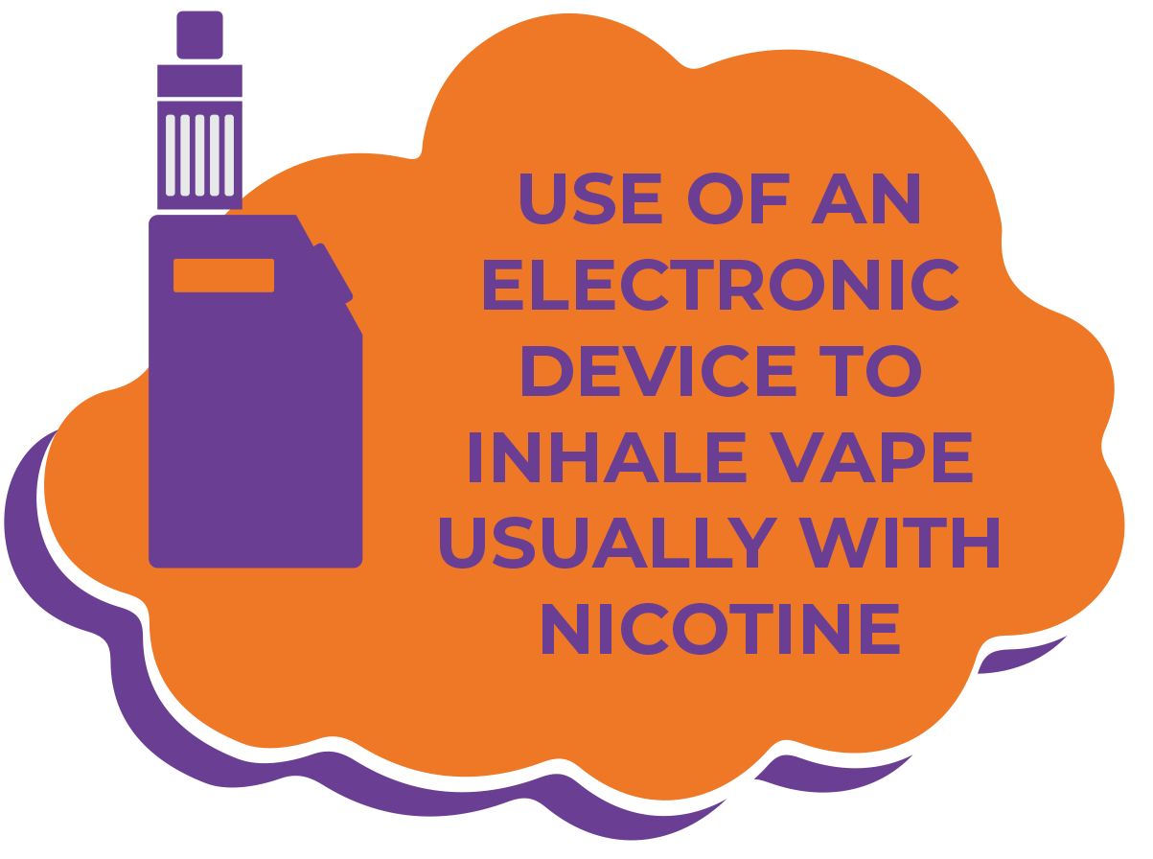
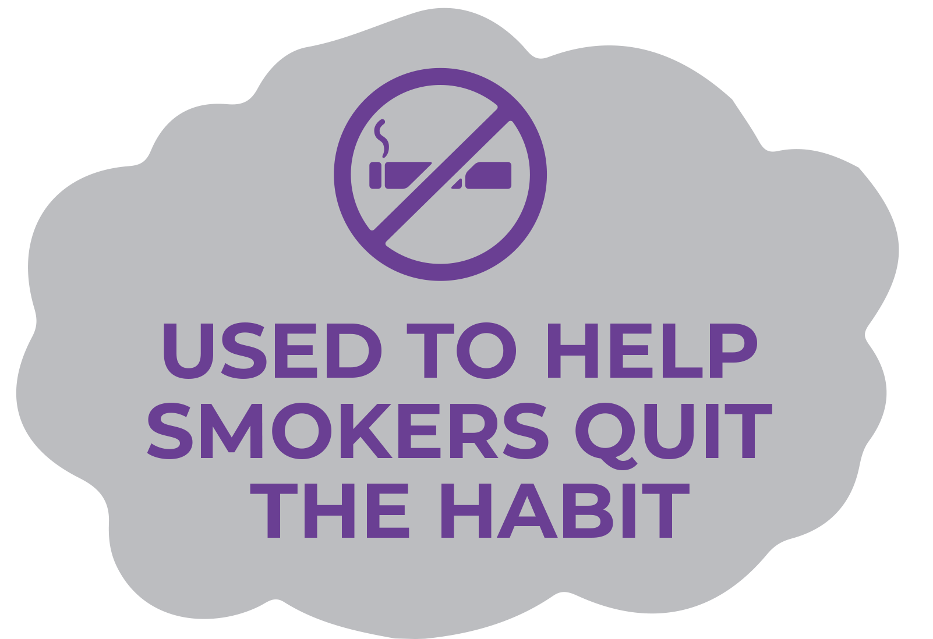
VAPING IS..

Slide 4
WHY DO PEOPLE CHOOSE TO VAPE?

Slide 5
PEOPLE MAY CHOOSE TO VAPE BECAUSE…
TO MAKE THEMSELVES FEEL MORE RELAXED
THE NEW SOCIAL NORM
ADDICTION
TO QUIT SMOKING CIGARETTES
TO IMPRESS PEOPLE/FRIENDS

Slide 6
ALTHOUGH MUCH BETTER THAN SMOKING THERE MAYBE SOME RISKS, IF ANY?

Slide 7
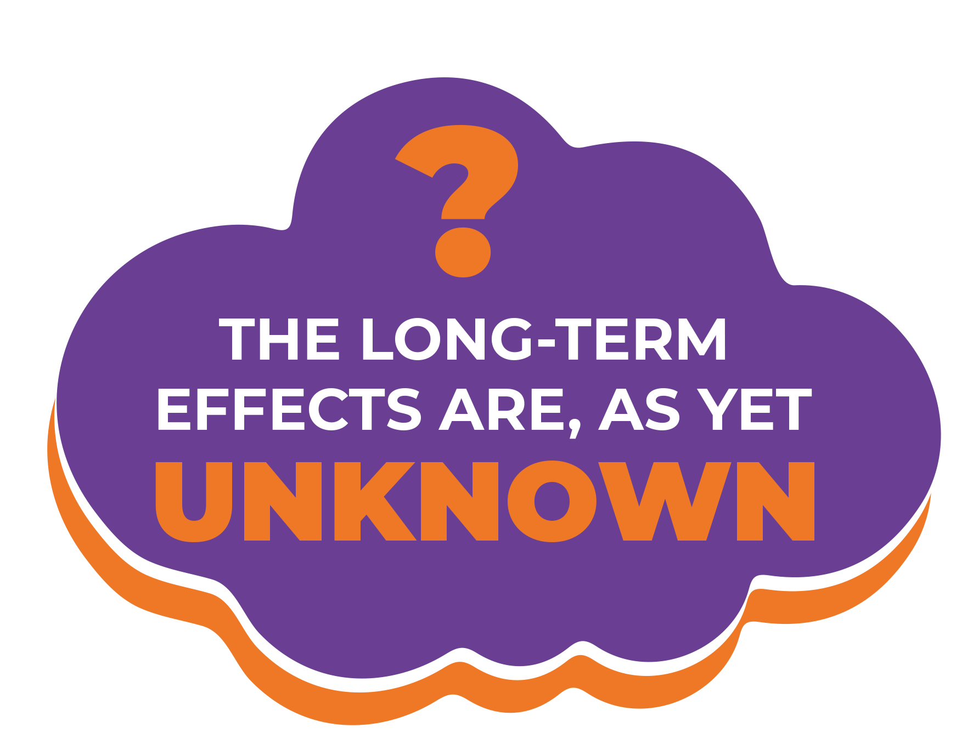
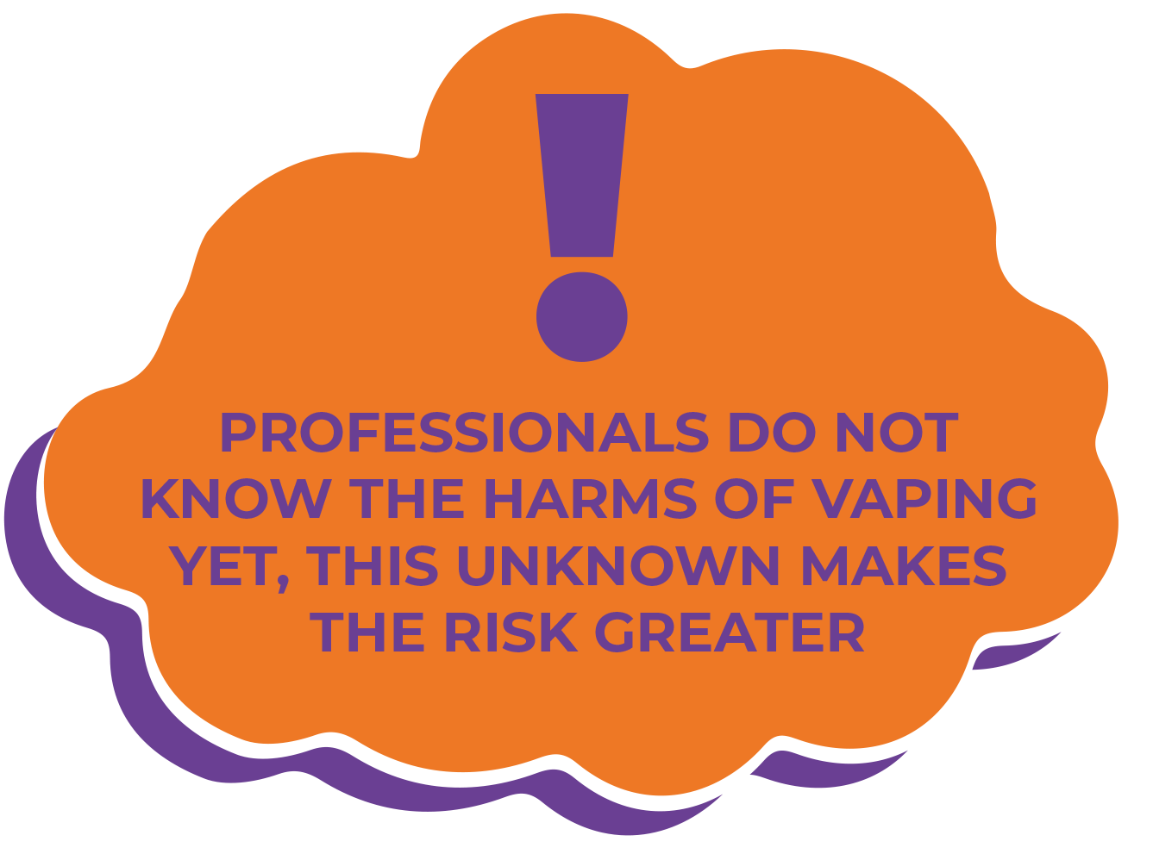
THE RISKS…
Short-term effects can include coughing, headaches, dizziness and sore throats.

Slide 8
HAVE YOU THOUGHT ABOUT THE ENVIRONMENT?

Slide 9
Single-use vapes contain batteries and difficult to recycle plastics.
These break down in landfills causing dangerous chemicals to pollute the soil and water.
The chemicals USED IN VAPES can cause harm to humans, animals and the environment
Approximately 1.3 million disposable vapes are thrown away every week in the UK: enough to cover 22 football pitches.

Slide 10
DO YOU THINK YOUNG PEOPLE SHOULD BE ABLE TO VAPE?
Notes:
THIS IS A SLIDE TO SPARK DEBATE AND HEALTHY CONVERSATIONS AROUND THE TOPIC. WHAT DO YOUR STUDENTS THINK AND FEEL?

Slide 11
DO YOU KNOW THE LAWS?

Slide 12
LAWS..
It’s illegal for adults to buy vapes for anyone under 18
Vapes and vaping products that contain nicotine are age-restricted.
It’s against the law to sell them to anyone under 18

Slide 13
Remember, vapes are meant to help smokers to quit for good.

Slide 14
If you don’t smoke, don’t start to vape

Slide 15
CLASS TASK (OPTION 1)
You have been tasked to create your own anti vaping marketing campaign!
Its time to get creative, your campaign will need a slogan, brand, logo, and theme. Think about how people can get involved, can they use a hashtag or filter to show they’re on board with the campaign?
Notes:
TASK BRIEF ATTACHED

Slide 16
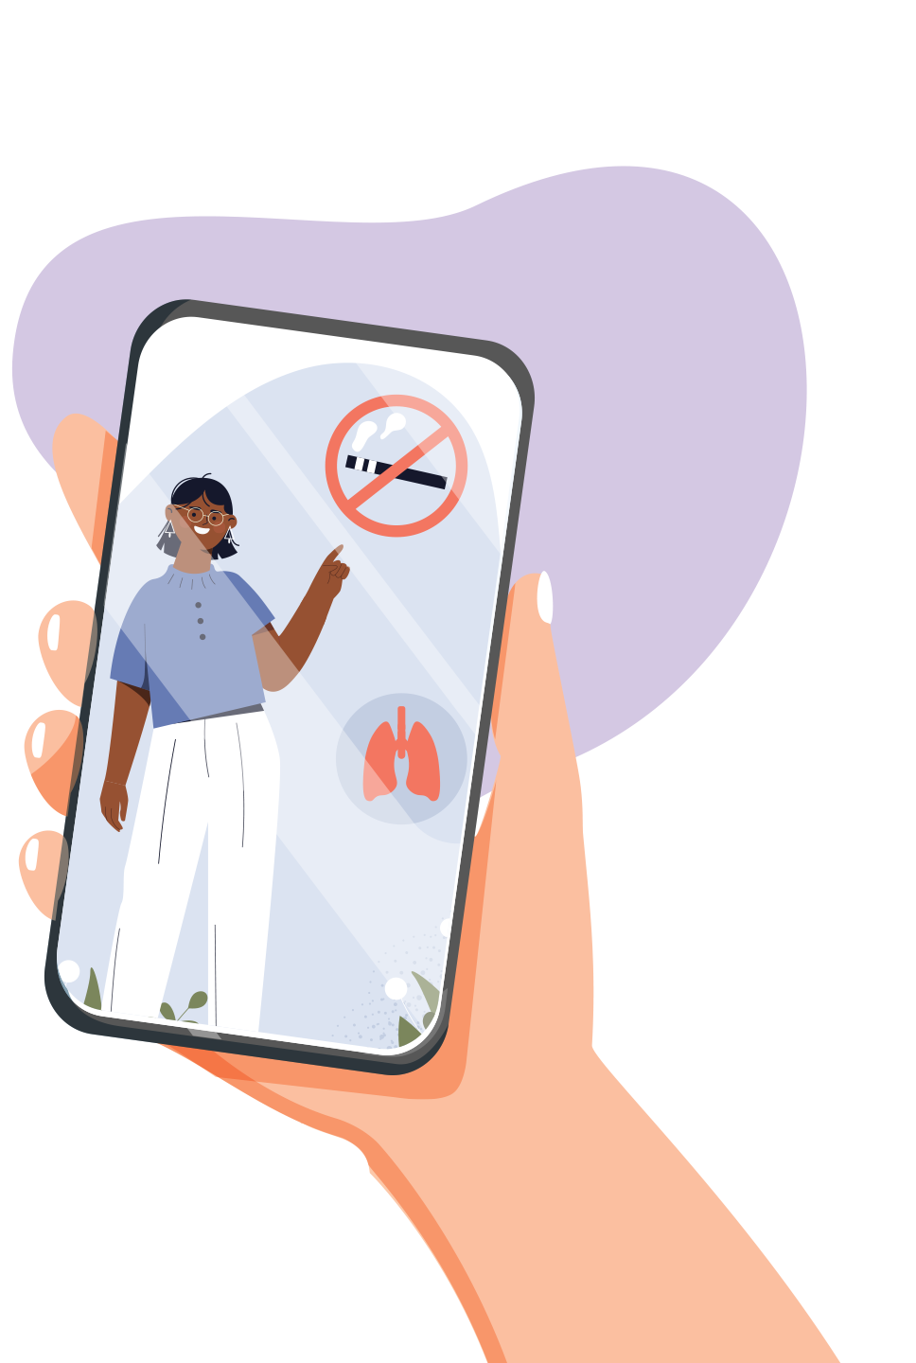
TASK (OPTION 2)
You have been tasked to create your very own TikTok video to inform younger people and students of the risks around vaping.
Its time to get creative, think about trends, sounds, filters and themes that you have seen on TikTok or social media recently. What do you enjoy watching?
Notes:
TASK BRIEF ATTACHED

